Slide 2
Things that Flash and Bleep

Slide 3
Week 1 & 2
Introducing the DHJS Bleep-o-Matic
Talk about electronic music
Inventors
Musicians
How to NOT get an electric shock and so avoid death
Everyone gets an electric shock (if they want to)
Lightbulbs and LEDs
How to blow up a LED
How to NOT blow up a LED
Make a circuit with a breadboard (flashing light)
Multi-coloured LED lights
Make a light trumpet on the breadboard (clue – it’s not really a trumpet)
Using a knob to mix colours
Experimentation – what can YOU make?
Week 3 & 4
Making your Bleep-o-Matics
Learn to Solder (if you want to)
Composing electronic music
Drawing your graphic score
Finish and perform compositions

Slide 4
Things will go wrong, that’s fine

Slide 5
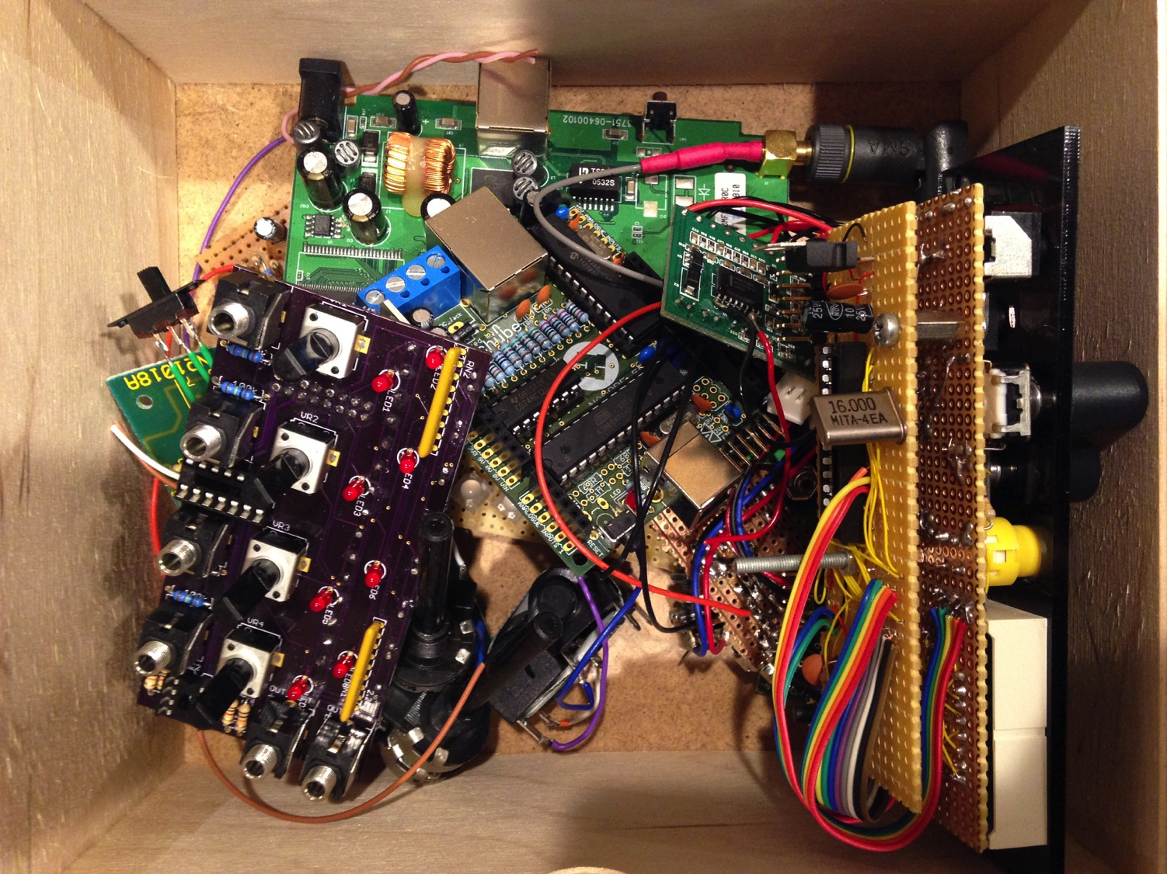

Slide 6
What is this all about?

Slide 7
Bleep - o - matic

Slide 8


Slide 9
Electronic Music
Notes:
What do you think electronic music is? What kind of musicians?
What’s the difference between electronic music and other music?
What kind of instruments?

Slide 10
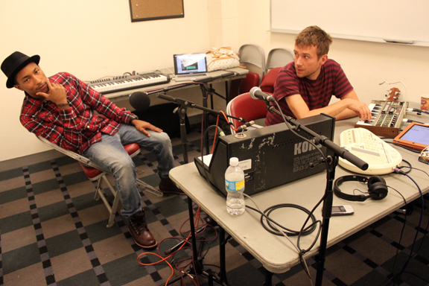
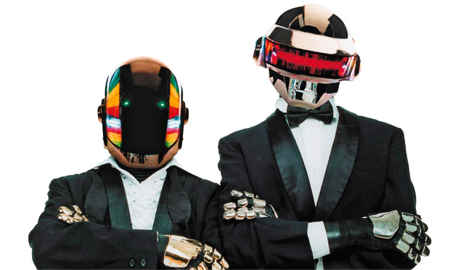

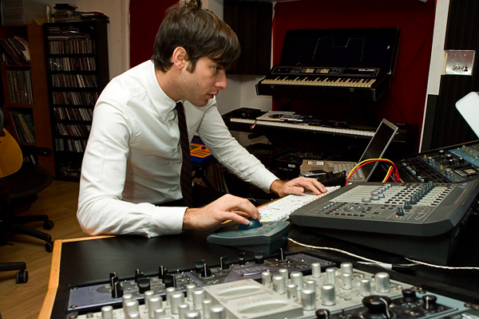

Slide 11
Inventors and musicians
Notes:
Delia Derbyshire – made the dr who theme music, worked for the BBC
Daphne Oram – she invented a machine that you can still see in the science musieum, that you programmed by painting on strips of film
Bob Moog – he invented a huge synthesizer with a keyboard – very very expensive, but all the pop stars of the 1960s bought one – the beatles and the rolling stones
Don Buchla (illustrated by Laurie Speigel) thought that these crazy new instruments should be more modern – he didn’t see why they should have an old fashioned piano keyboard so he made synthesizers that just had loads of knobs and controls and buttons

Slide 12
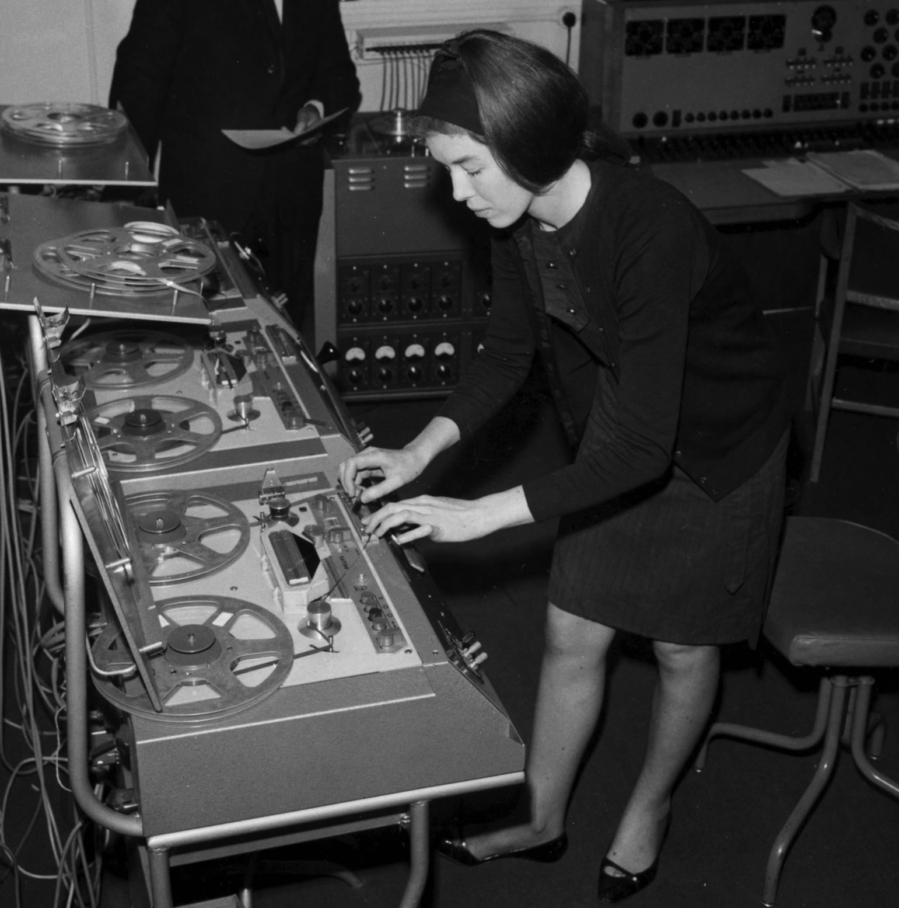

Slide 13
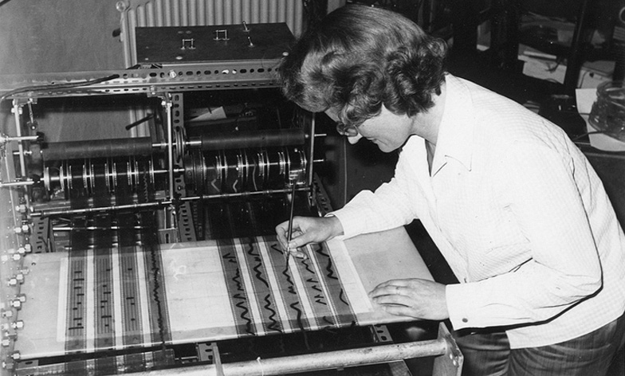

Slide 14
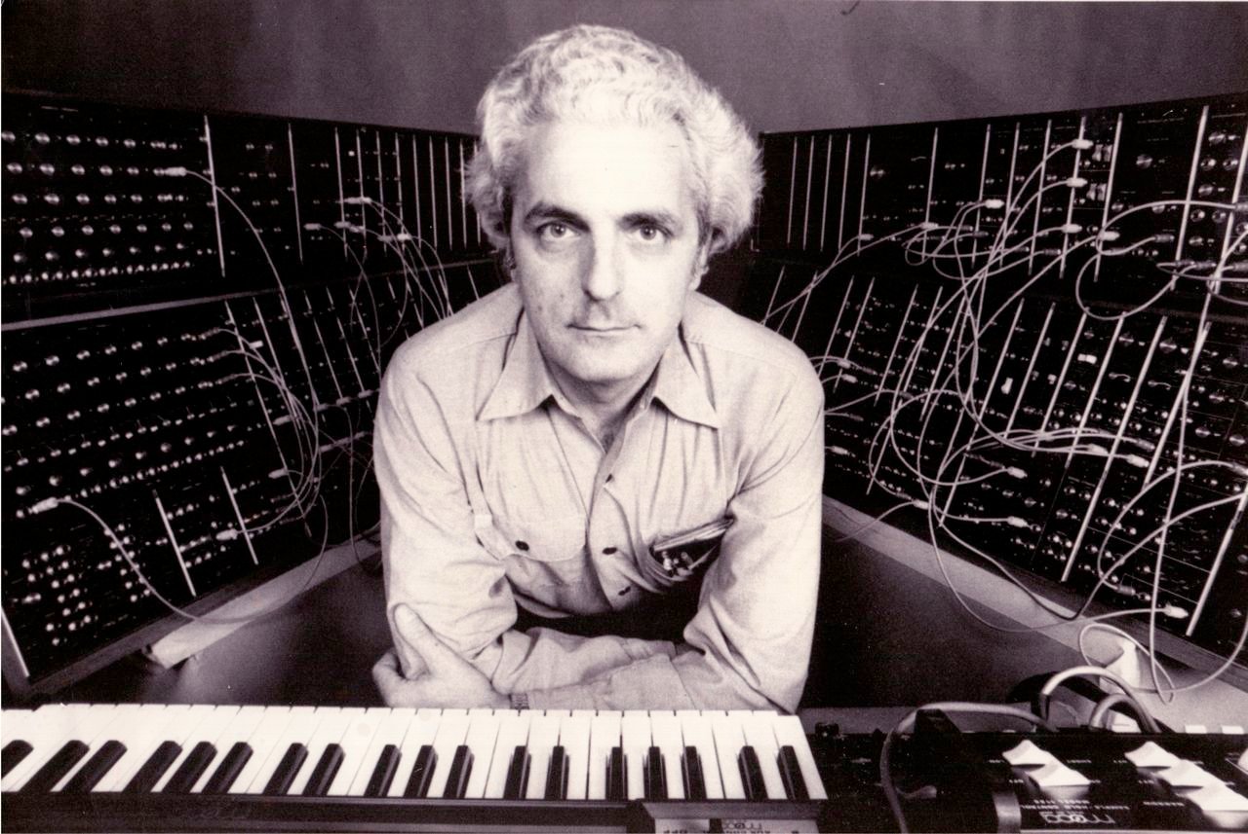

Slide 15
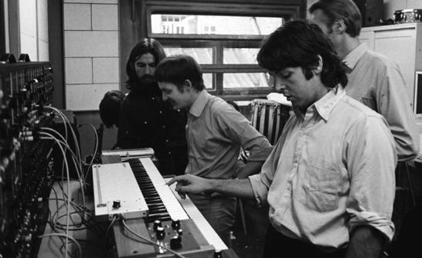

Slide 16
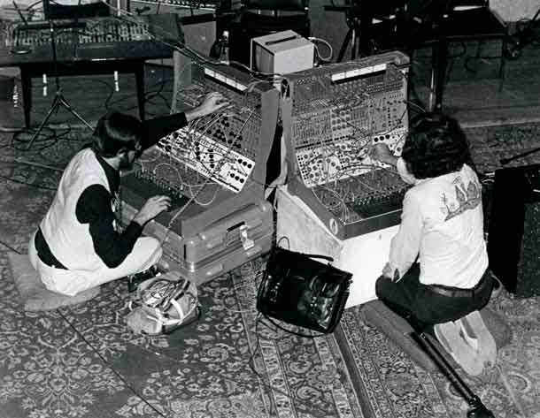

Slide 17
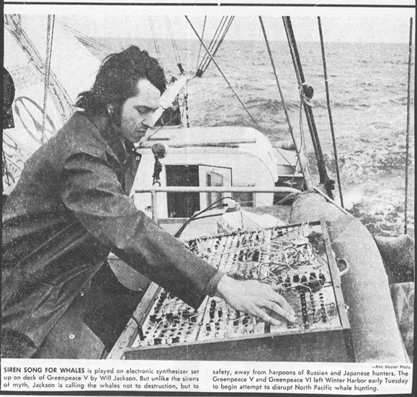

Slide 18
Why is electricity dangerous?

Slide 19


Slide 20
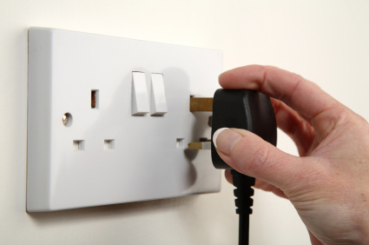
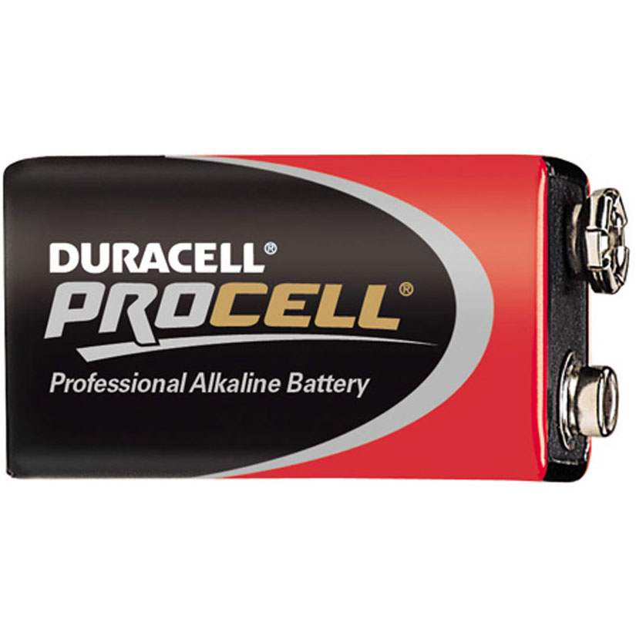
Notes:
§

Slide 21
Experiment 1: Get an electric shock (if you want to)

Slide 22
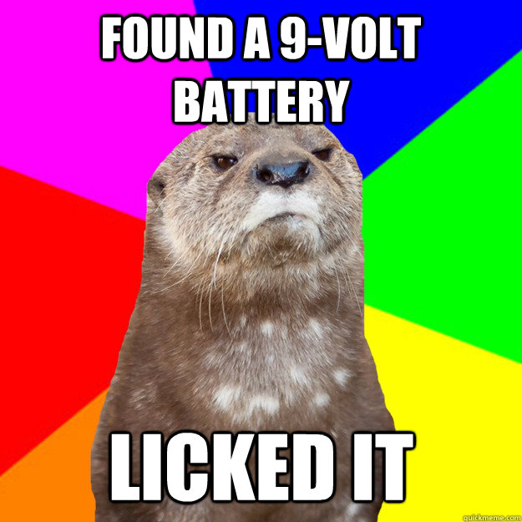

Slide 23
What did you notice?

Slide 24
What if you only lick one side?

Slide 25
Experiment 2: Light up a little bulb

Slide 26
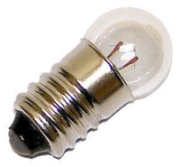

Slide 27
What did you notice?

Slide 28
Experiment 3: Light up and blow up an LED

Slide 29
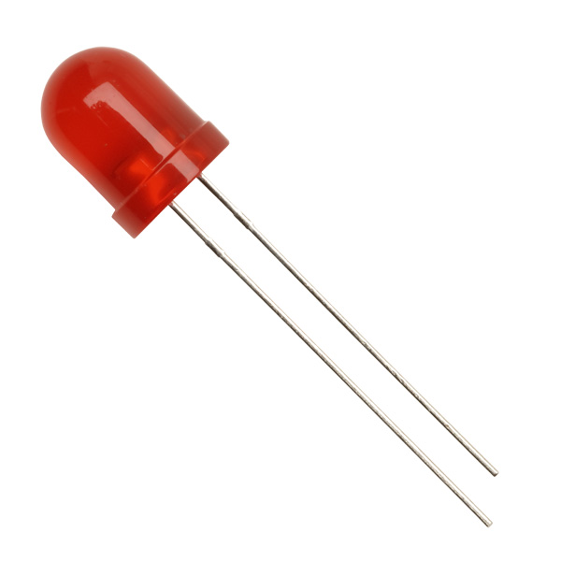
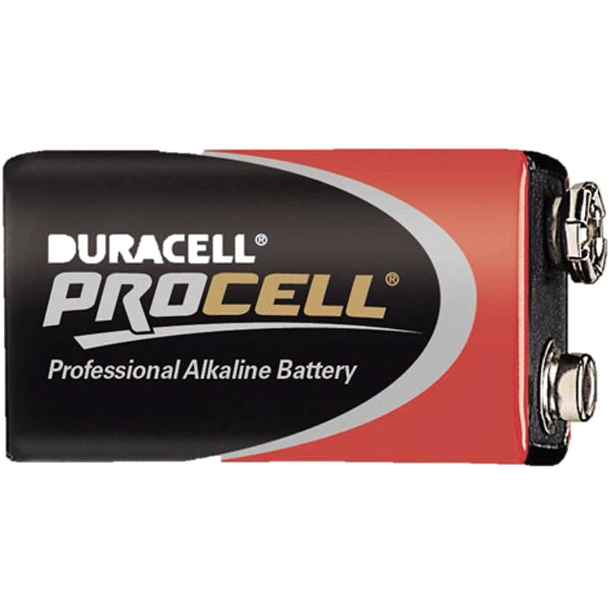

Slide 30
What did you notice?

Slide 31
Experiment 4: Light up an LED properly

Slide 32
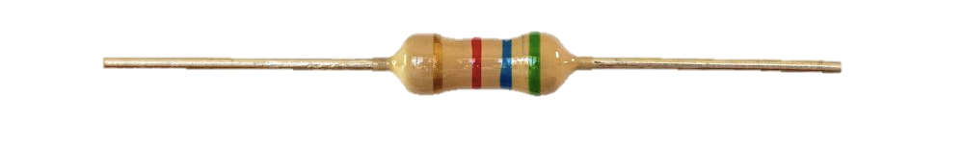

Slide 33
What did you notice?

Slide 34
How to use a breadboard

Slide 36
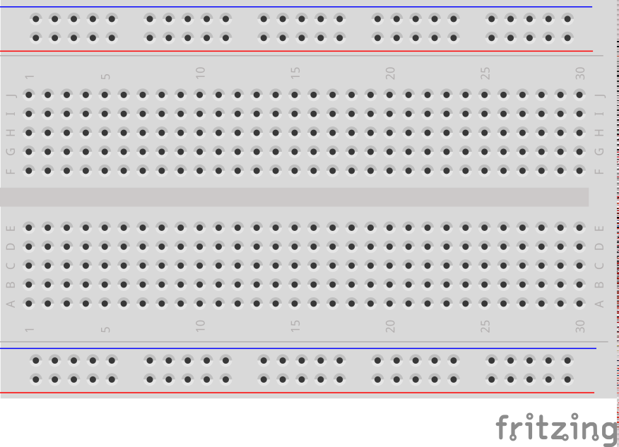

Slide 38
Experiment 5 Lighting up an LED on the breadboard

Slide 39
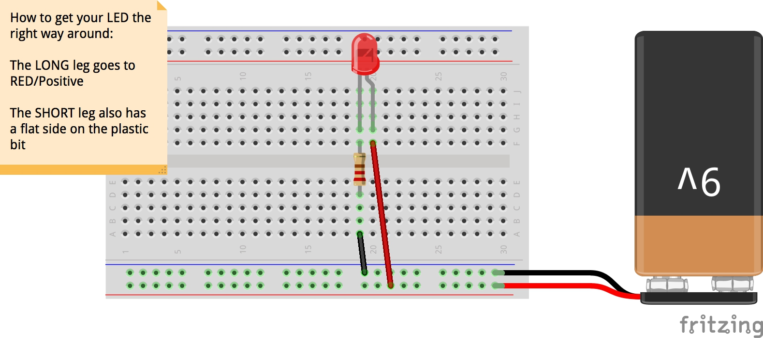

Slide 40
Experiment 6 Make a light you can FLASH

Slide 41
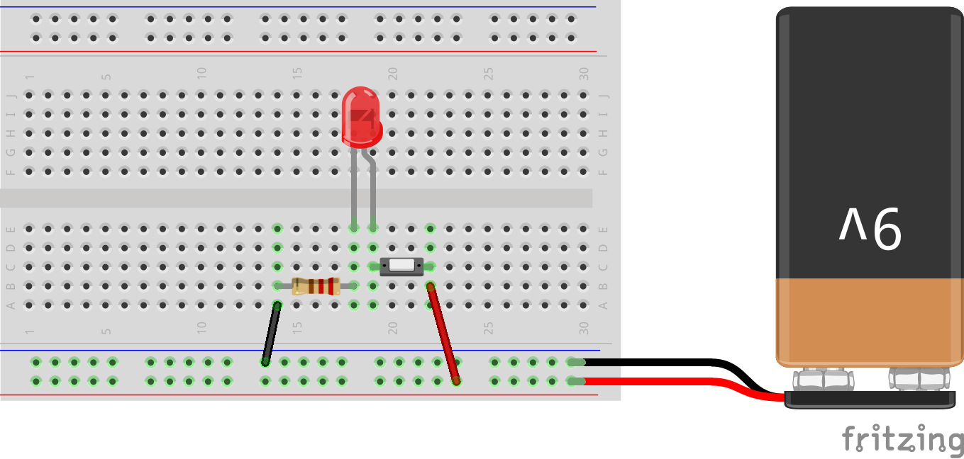
Notes:
Got to here in week one

Slide 42
End of Week 1

Slide 43
Experiment 7 Lots of flashing lights

Slide 44
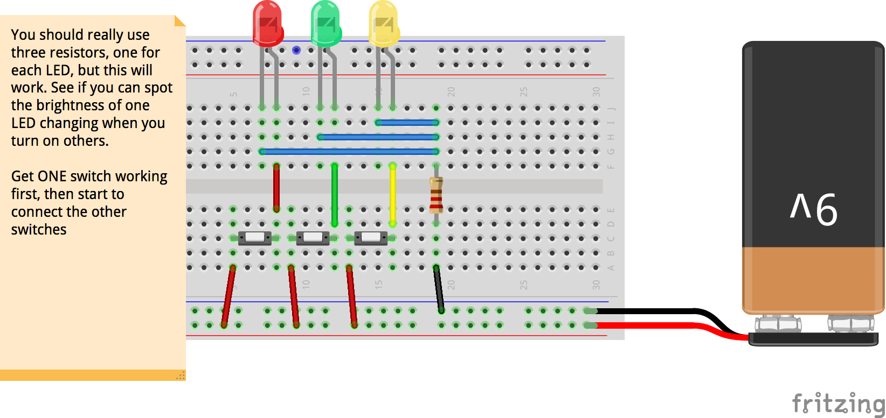

Slide 45
Experiment 8 Light Trumpet

Slide 46
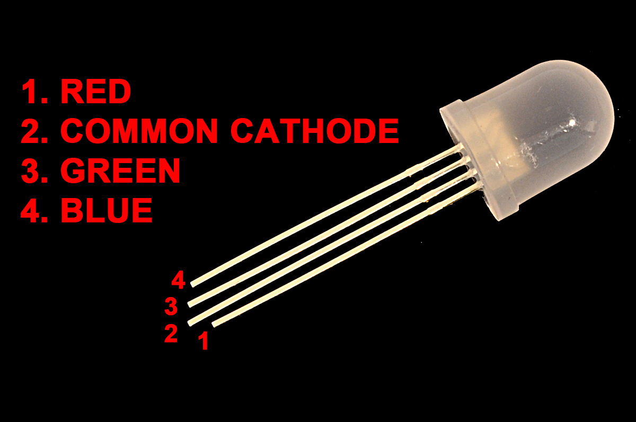

Slide 47
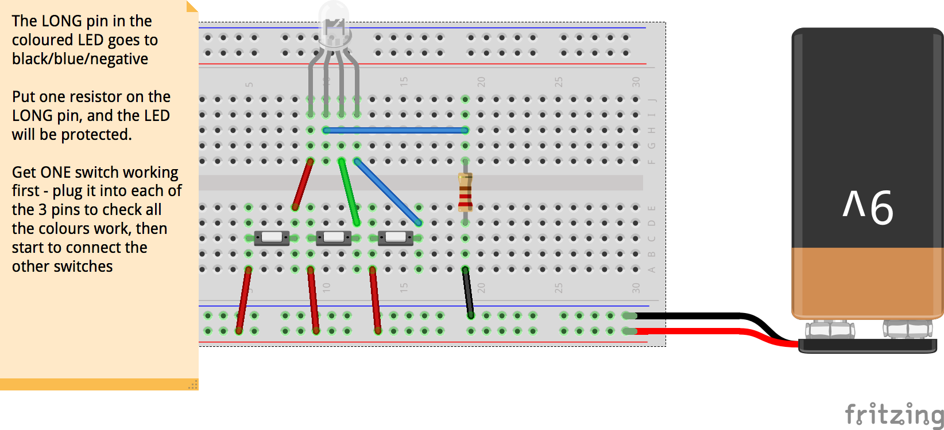

Slide 48


Slide 49
Experiment 9 Light Mixer

Slide 50
First: STOP, clear off your breadboard Put ALL your resistors, wires, and LEDs into the bag

Slide 51
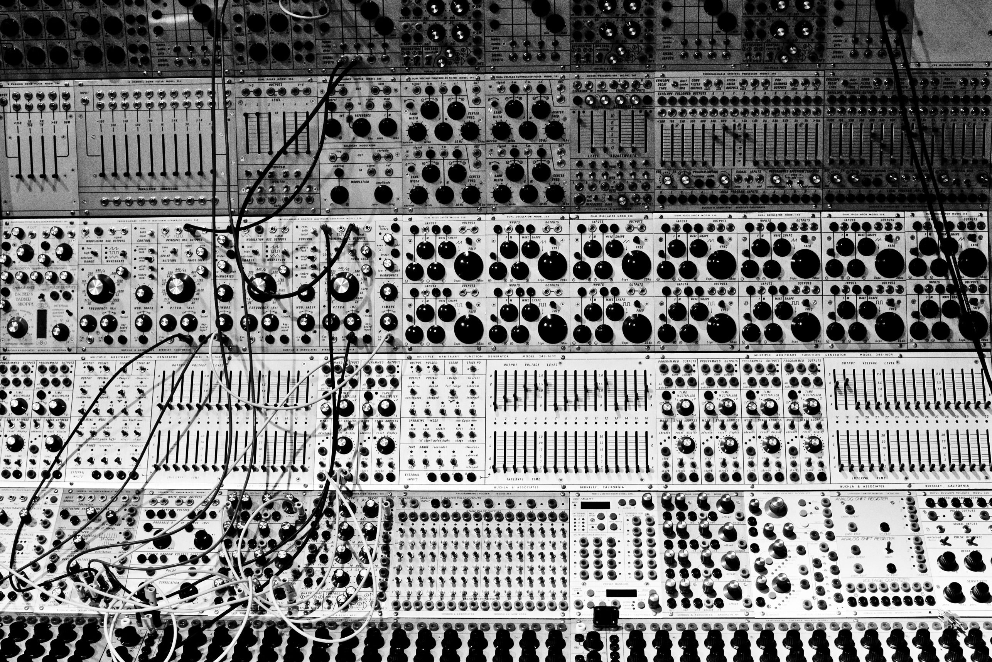

Slide 52

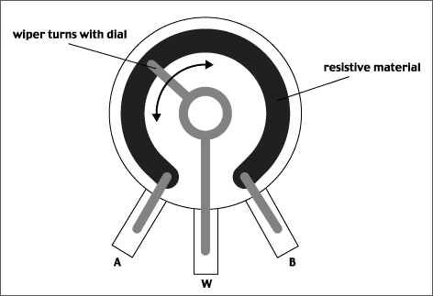

Slide 53
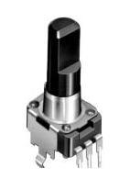
BEND OR SNIP OFF THESE TAGS
NOT THESE ONES!

Slide 54
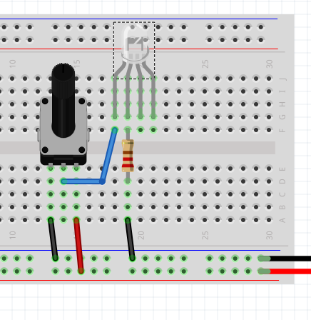

Slide 55
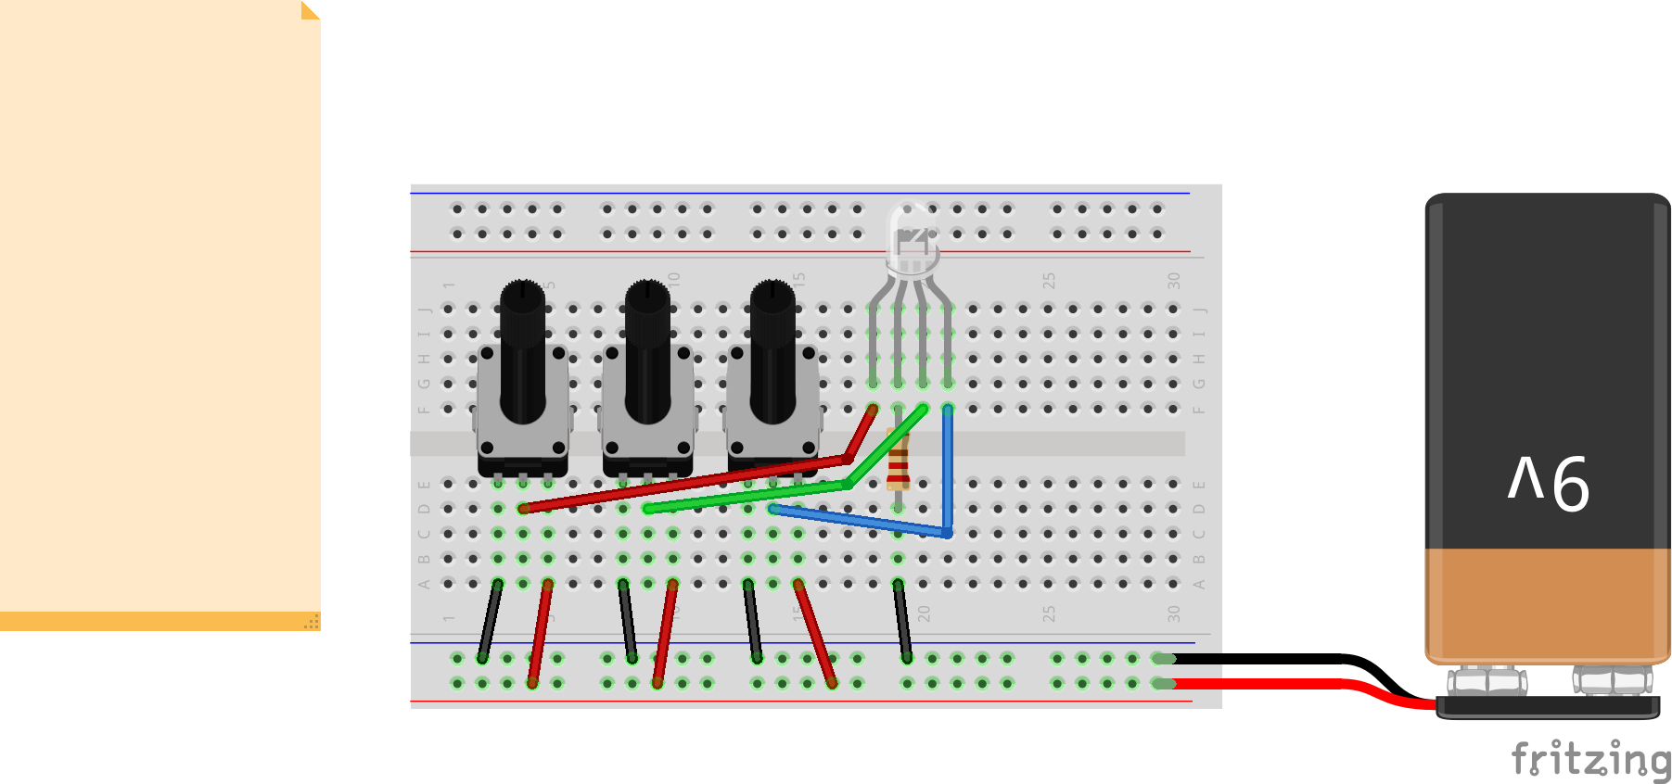

Slide 57
End of Week 2

Slide 58
Colours finished Next up: SOUND

Slide 59
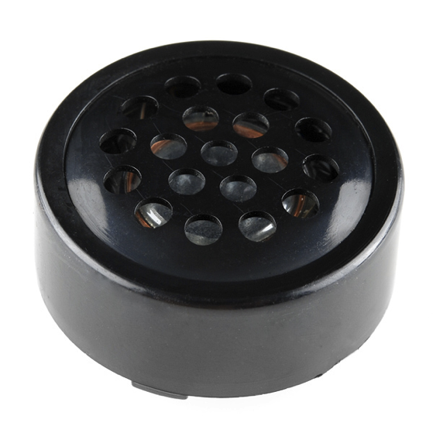
Experiment 10
+
= ?

Slide 60
Why didn’t it work?

Slide 61
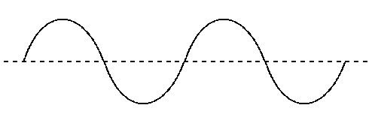
What is a sound? How does it look?

Slide 62
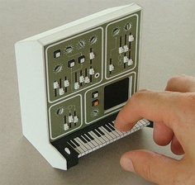
Experiment 11 Make a tiny little synthesizer
Not like this one, sorry

Slide 63
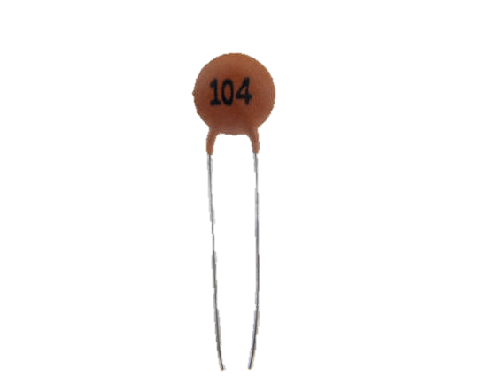
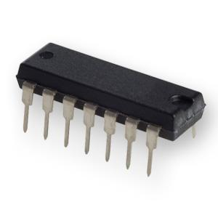
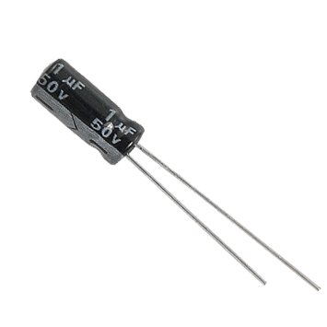

Slide 64
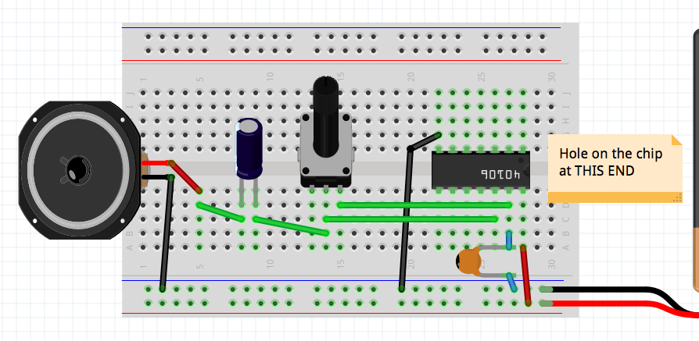

Slide 65
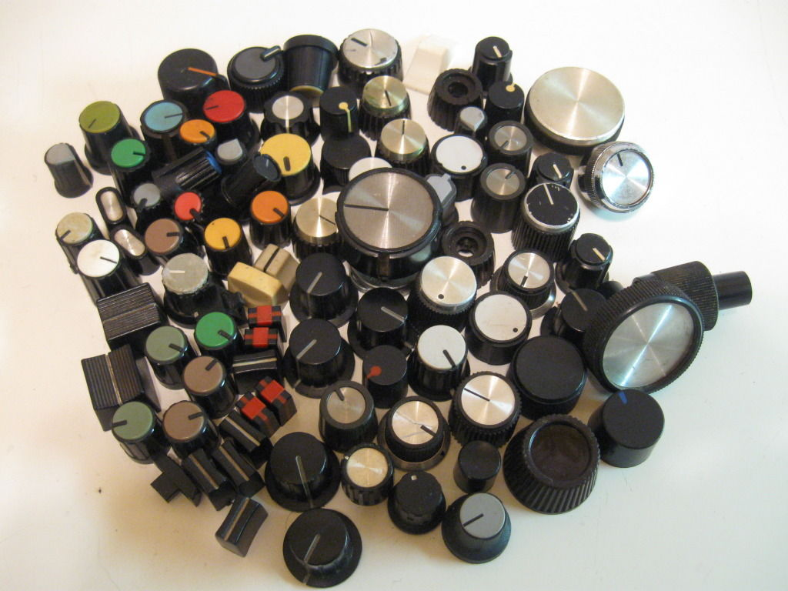

Slide 66
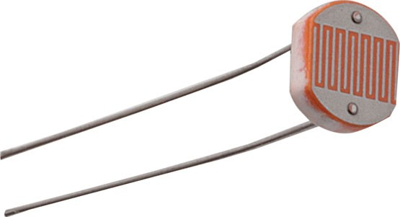
Experiment 12 What can you do with this?

Slide 67
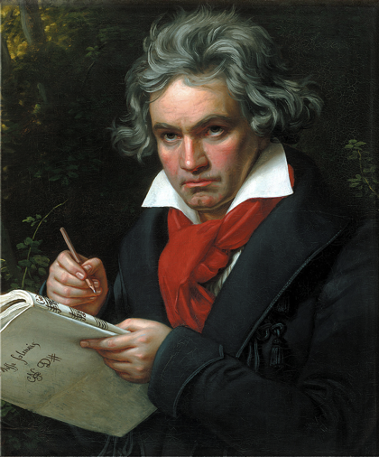
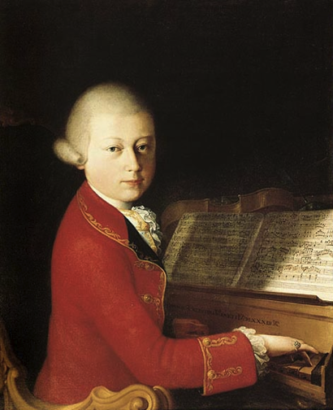

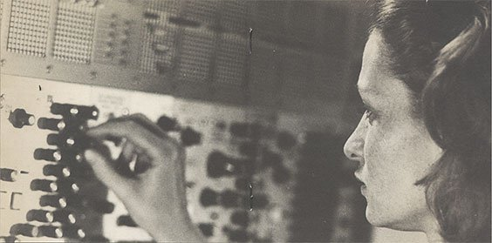
Experiment 13 Composing

Slide 68
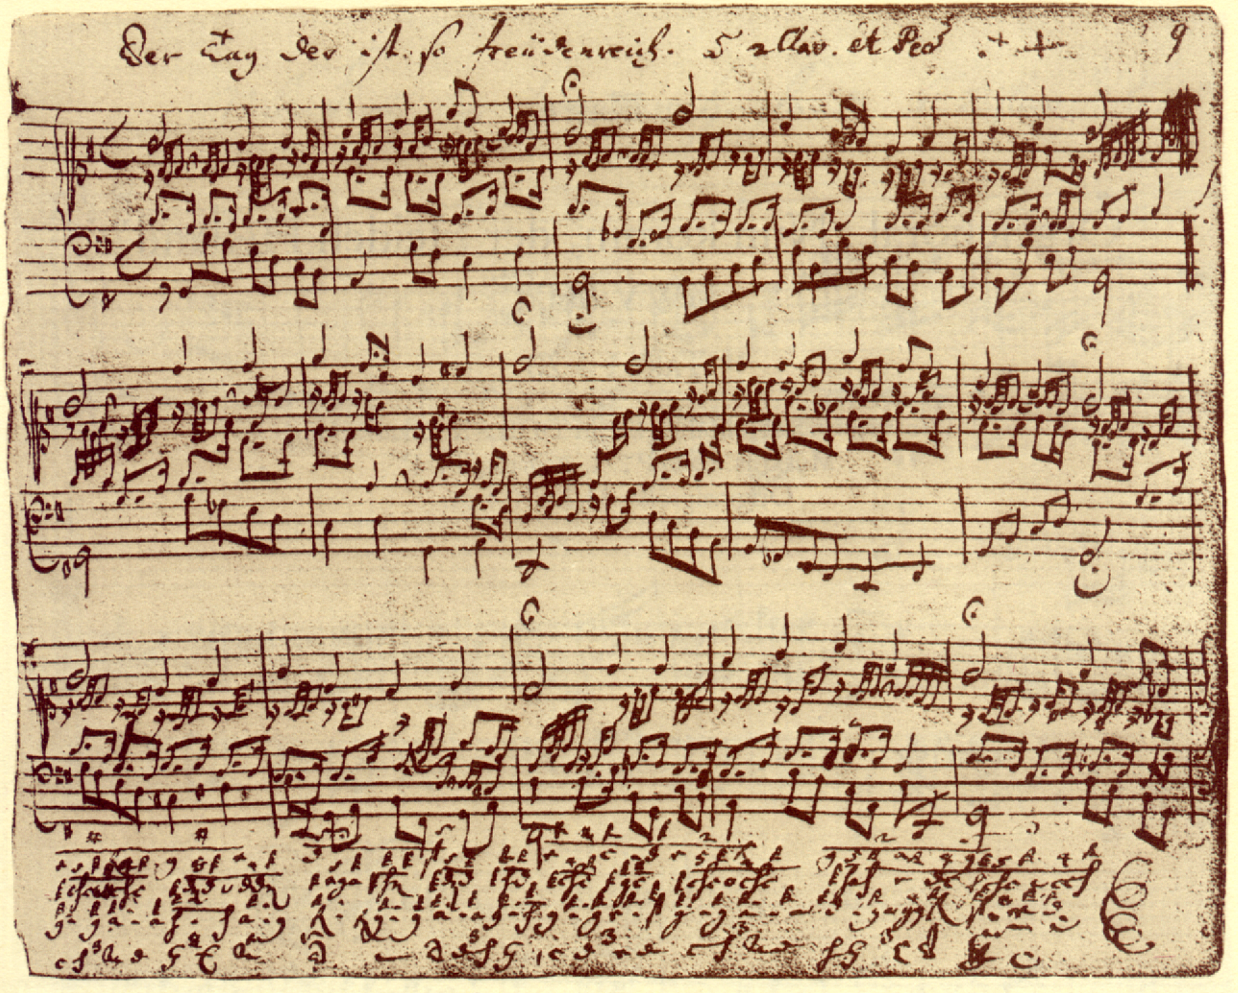

Slide 69
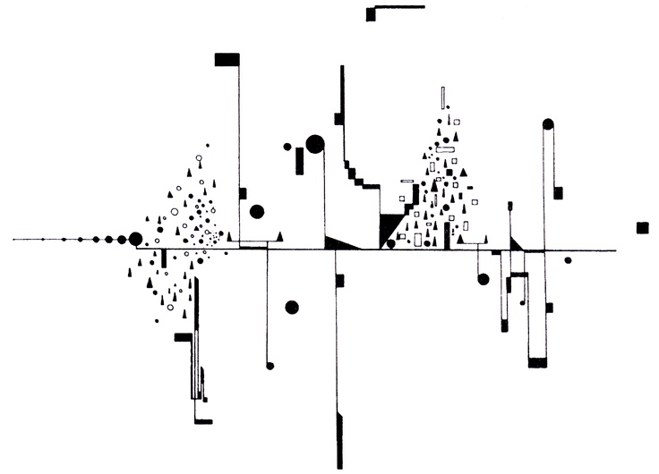

Slide 70
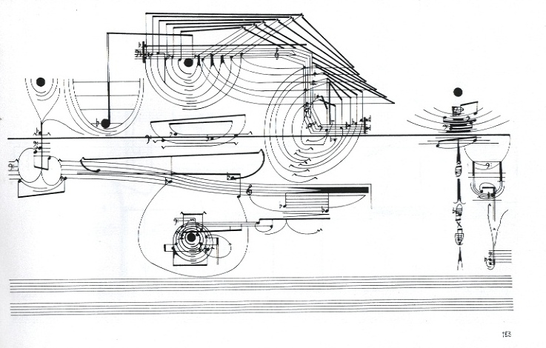

Slide 71
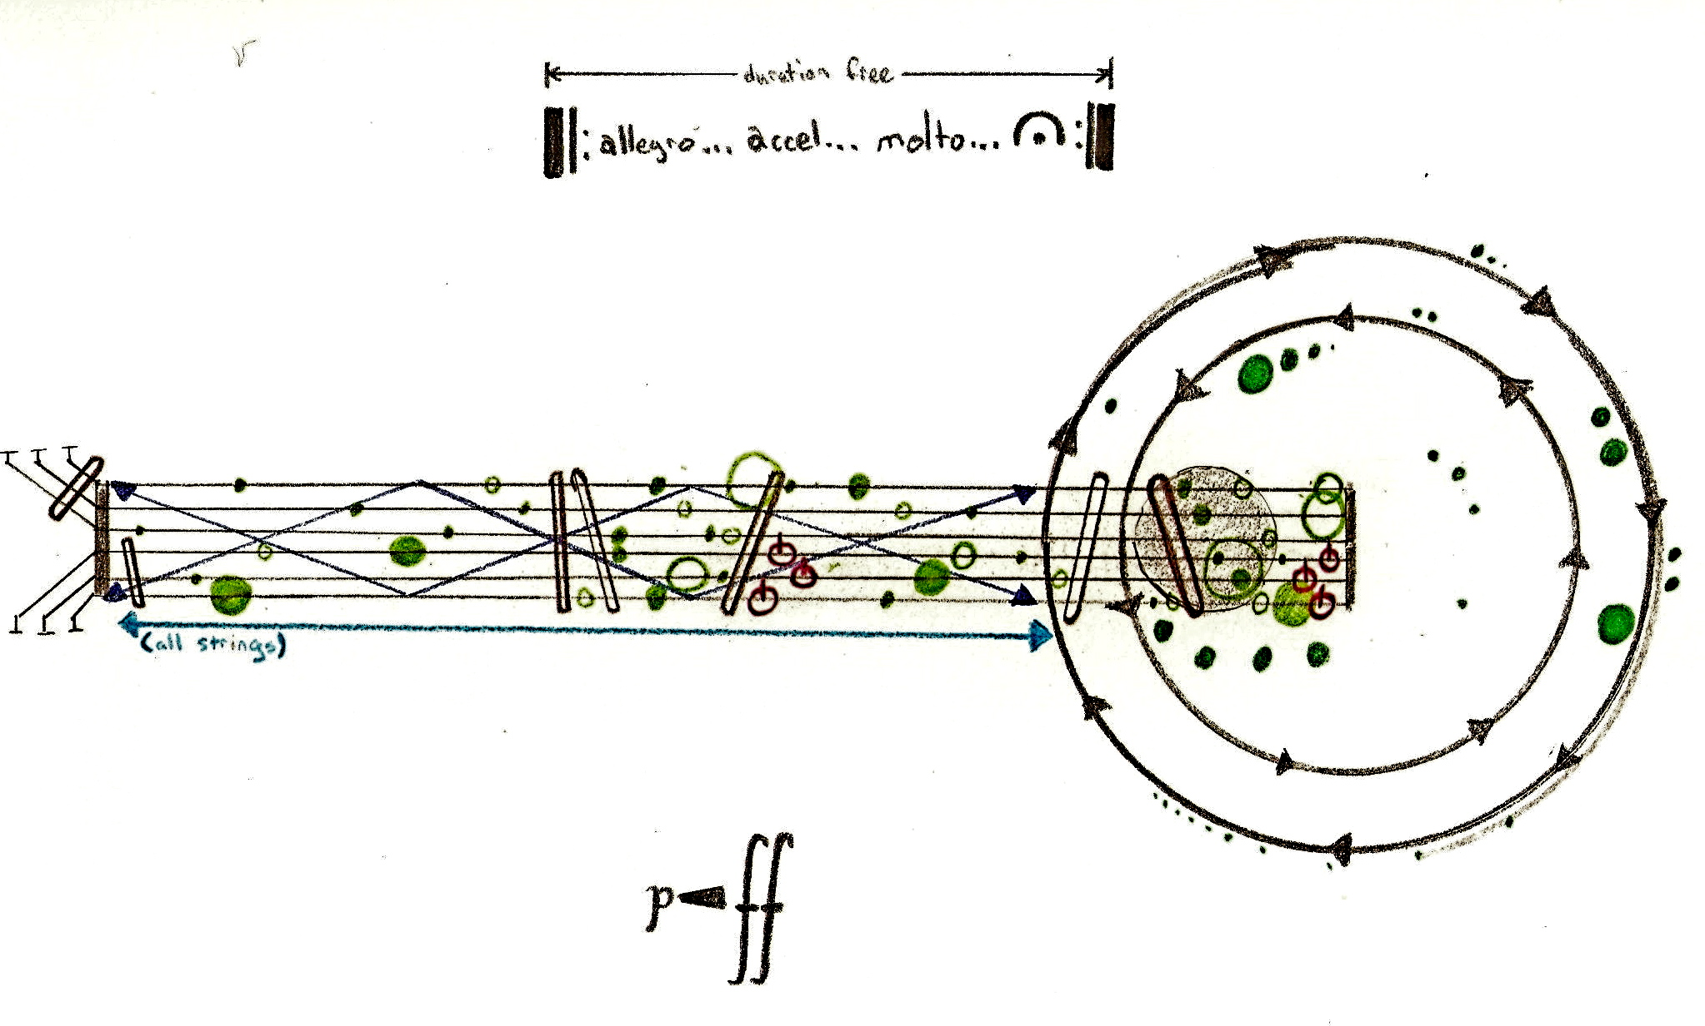

Slide 72
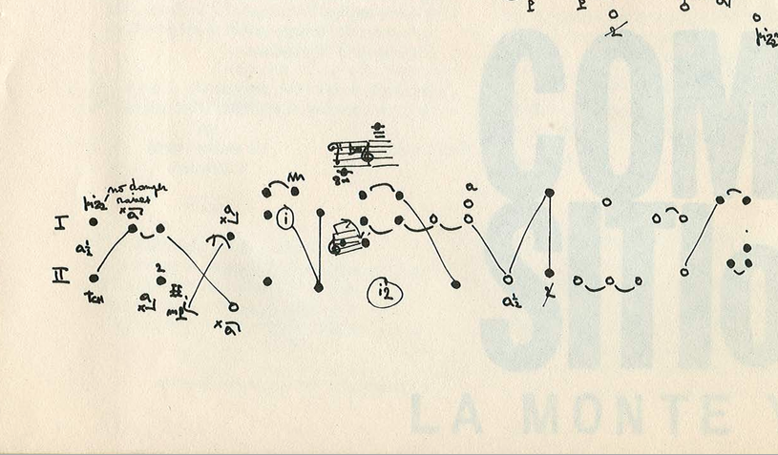

Slide 73
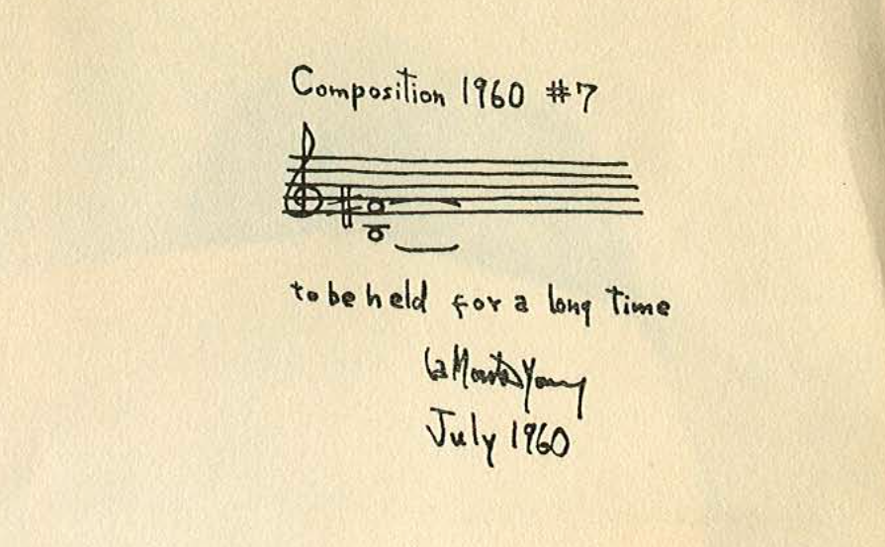

Slide 74
